Slide 1
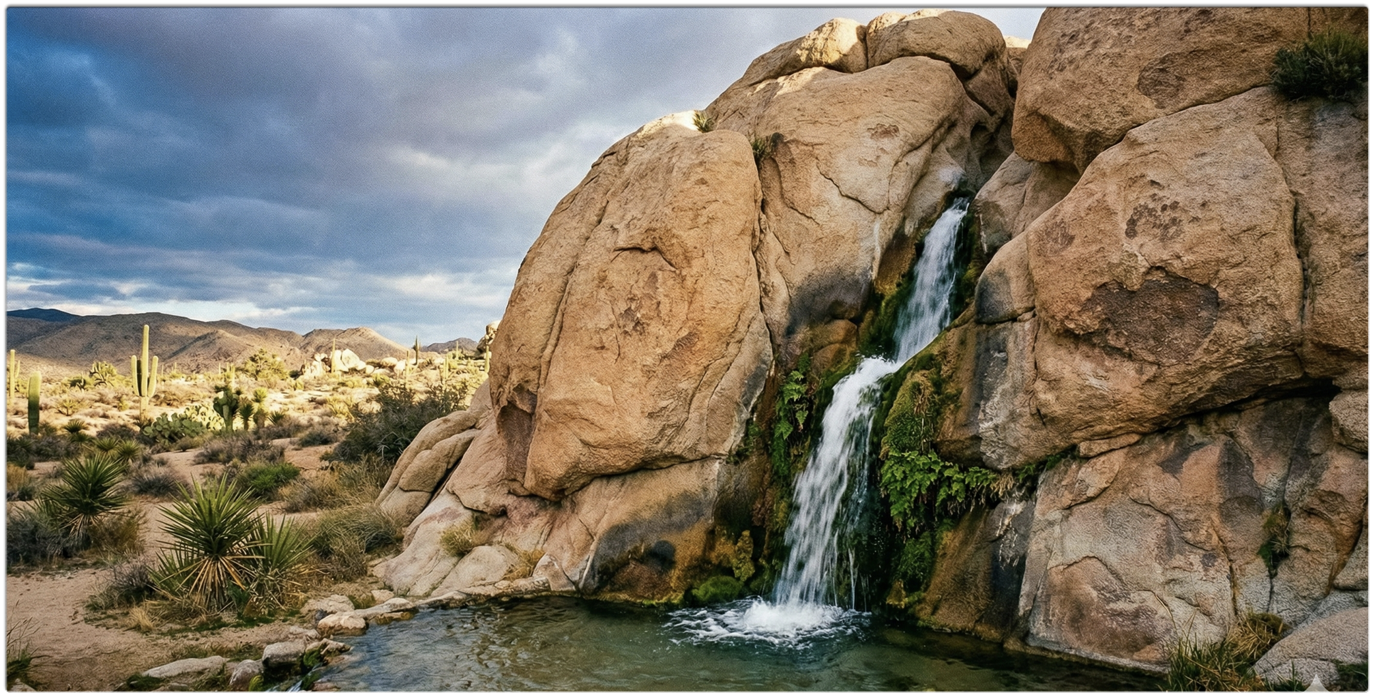
Echoes of Mercy
In The Wilderness
Notes:
Isaiah 43:1-7

Slide 2
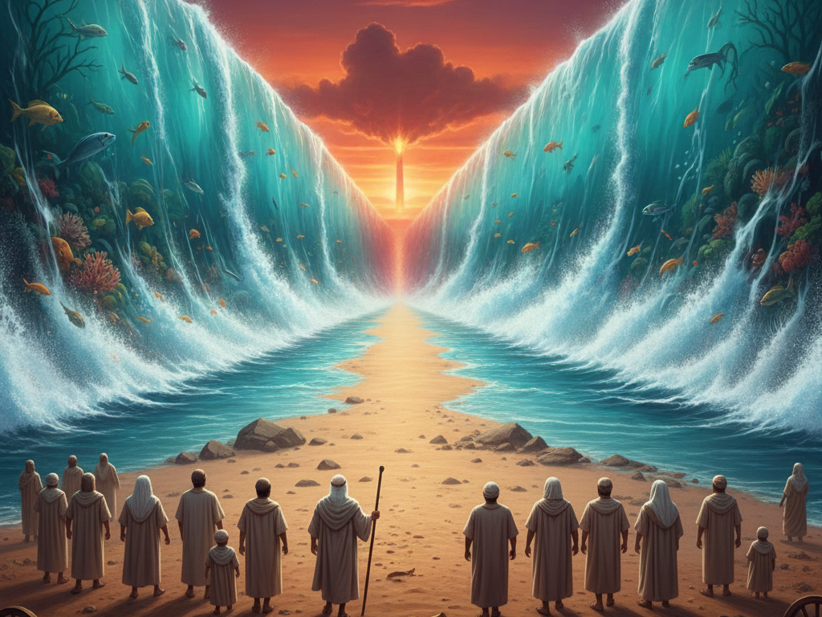
Notes:
Exodus 14:22 And the children of Israel went into the midst of the sea upon the dry ground: and the waters were a wall unto them on their right hand, and on their left.
54-0719E | God Providing Healing For This Generation
…but the way stayed, the water stayed their places, and the children of Israel walked across on dry land; and the unbelievers trying to walk across drowned in the act. He’s God. He will provide. He’s always provided.

Slide 3
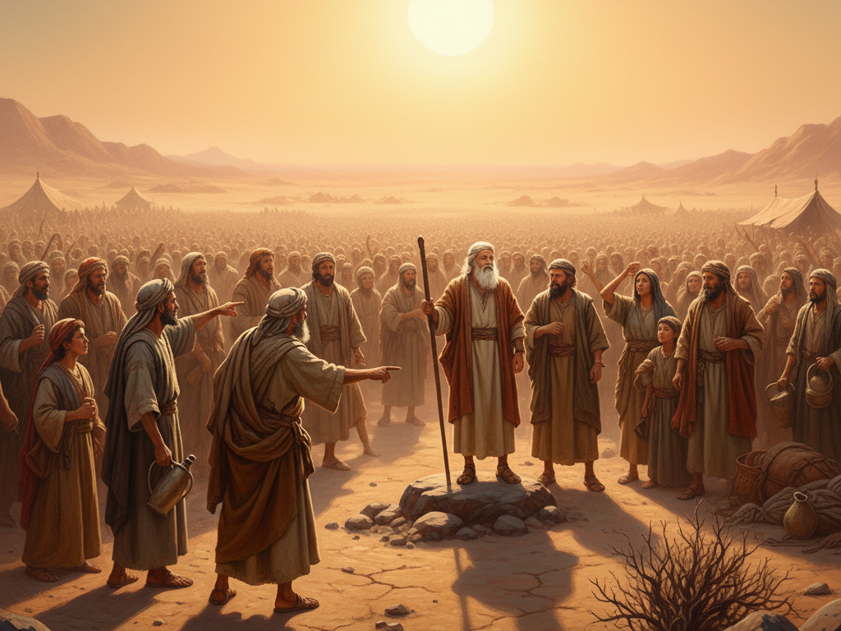
Notes:
Exodus 15:22 So Moses brought Israel from the Red sea, and they went out into the wilderness of Shur; and they went three days in the wilderness, and found no water.

Slide 4
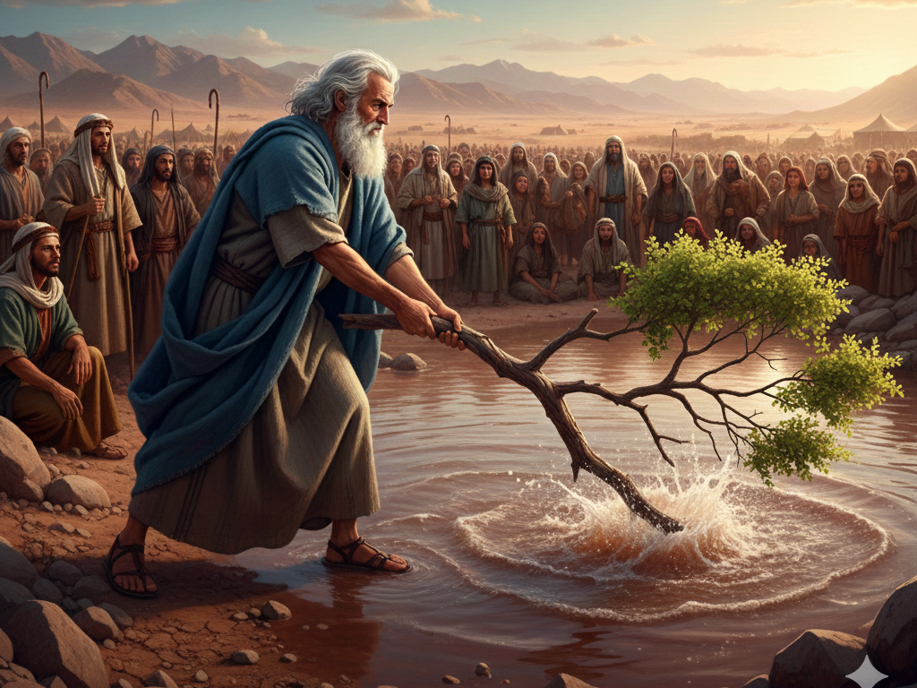
Notes:
54-0330 | Redemption In Completeness, In Joy
Could you imagine God taking His children, right after they got saved and filled with the Holy Ghost, to fountains of bitter water? Sure. He’d like to express His love to them again.

Slide 5
Notes:
Exodus 16:1 And they took their journey from Elim, and all the congregation of the children of Israel came unto the wilderness of Sin…

Slide 6
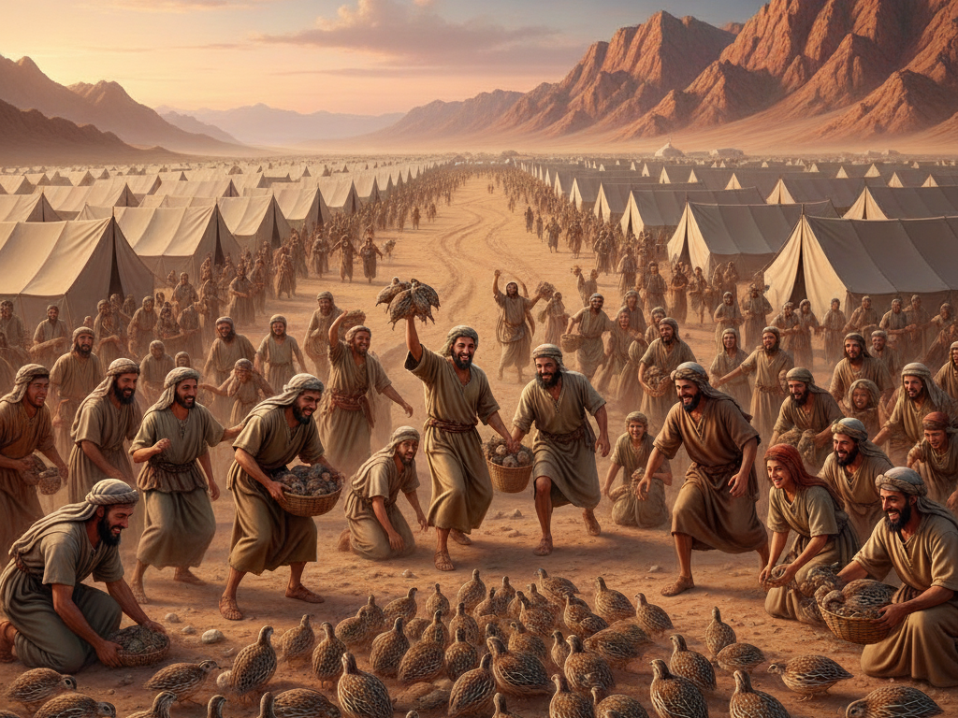
Notes:
Exodus 16:13 And it came to pass, that at even the quails came up, and covered the camp: and in the morning the dew lay round about the host.

Slide 7
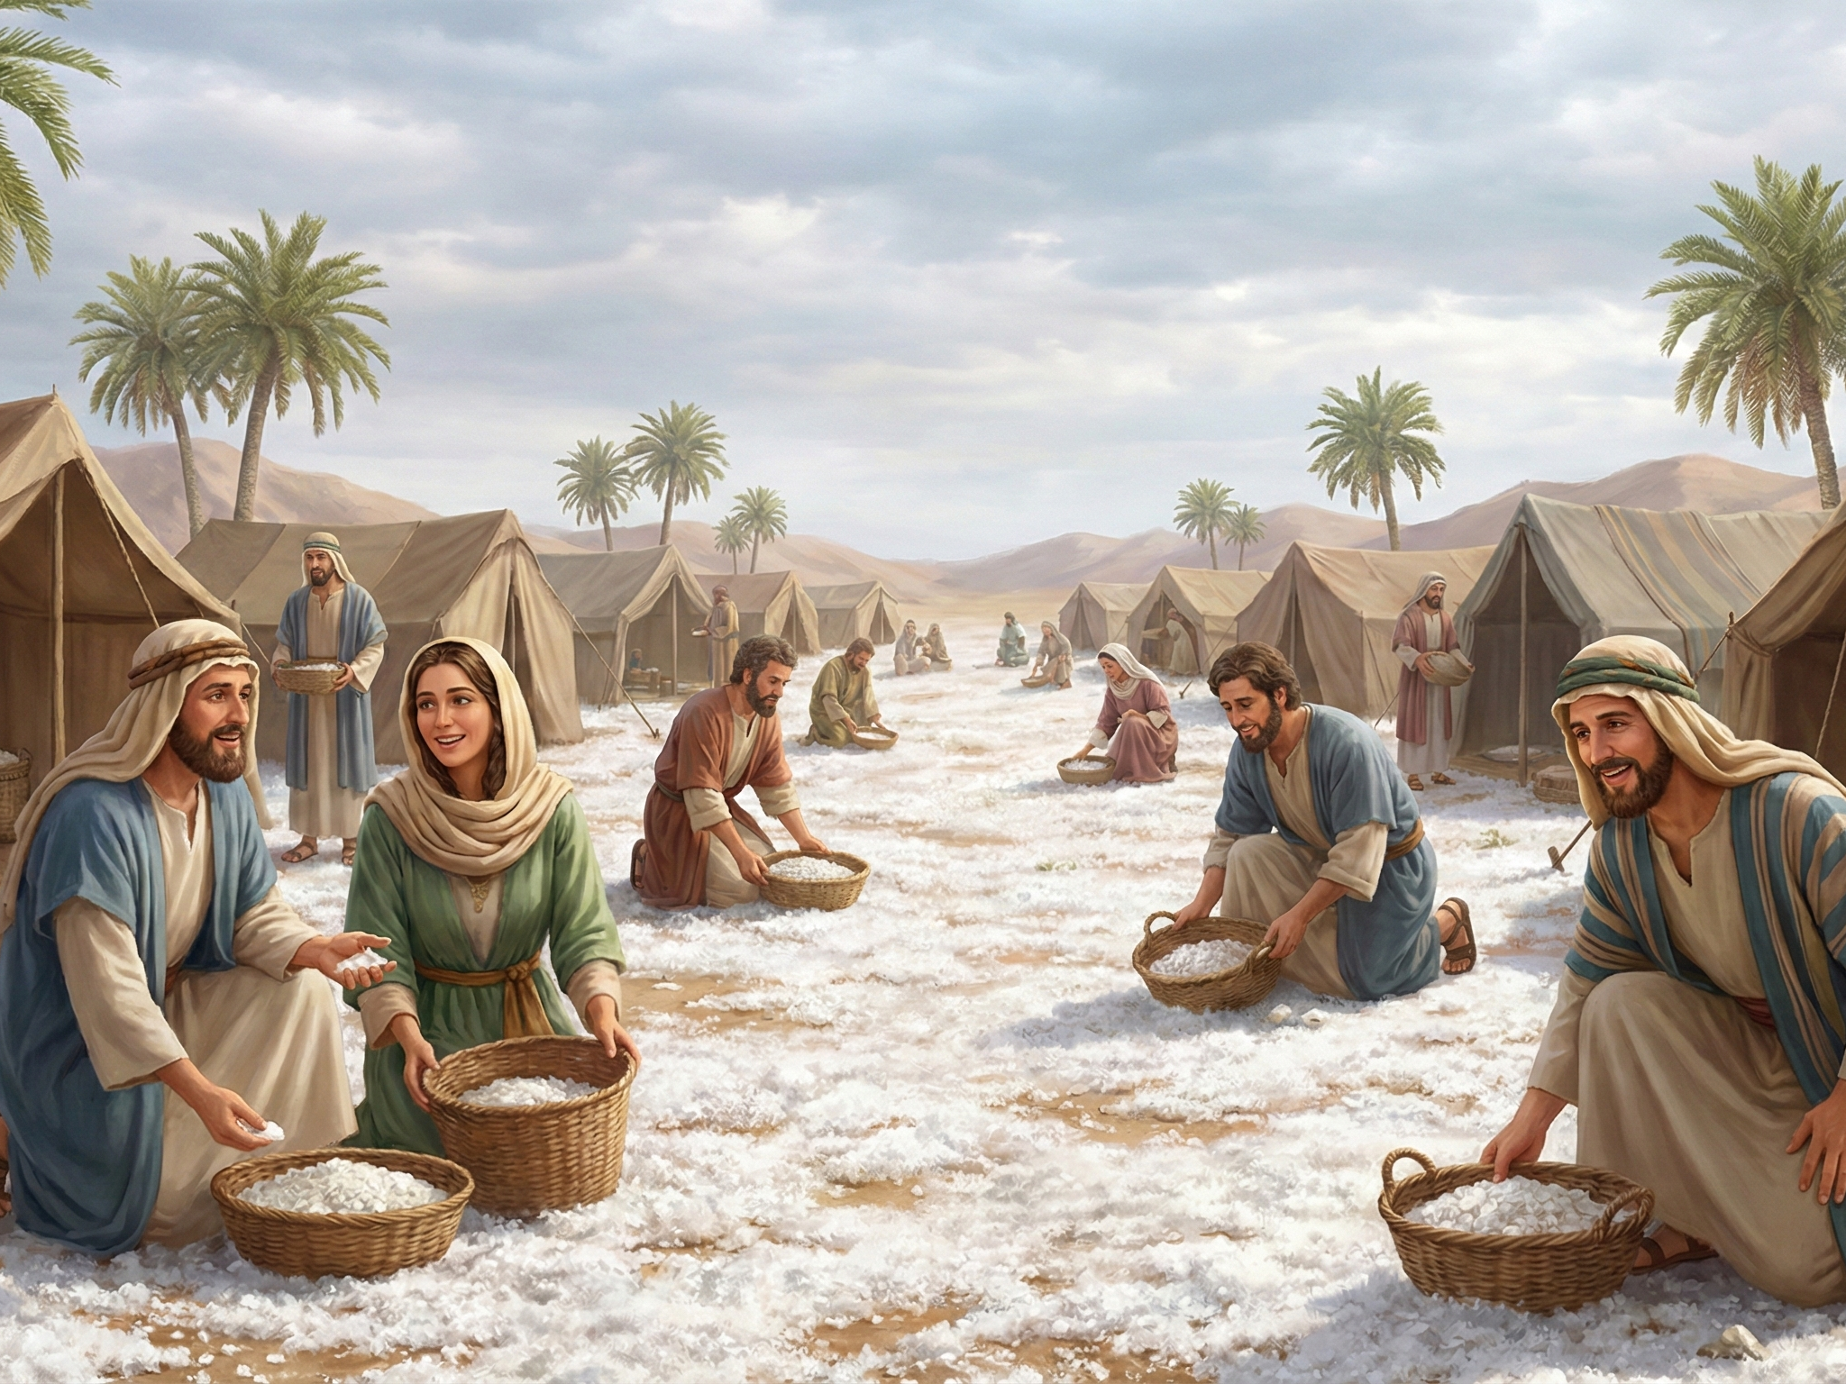
Notes:
Exodus 16:14 And when the dew that lay was gone up, behold, upon the face of the wilderness there lay a small round thing, as small as the hoar frost on the ground.

Slide 8
Notes:
Exodus 17:1 And all the congregation of the children of Israel journeyed from the wilderness of Sin, after their journeys, according to the commandment of the LORD, and pitched in Rephidim: and there was no water for the people to drink.

Slide 9
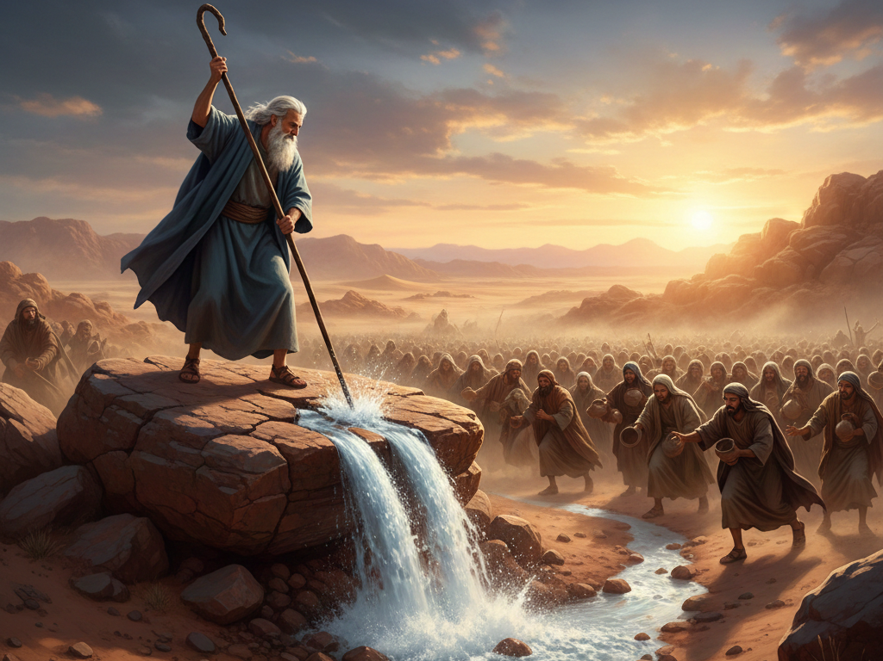
Notes:
Exodus 17:6 Behold, I will stand before thee there upon the rock in Horeb; and thou shalt smite the rock, and there shall come water out of it, that the people may drink. And Moses did so in the sight of the elders of Israel.

Slide 10
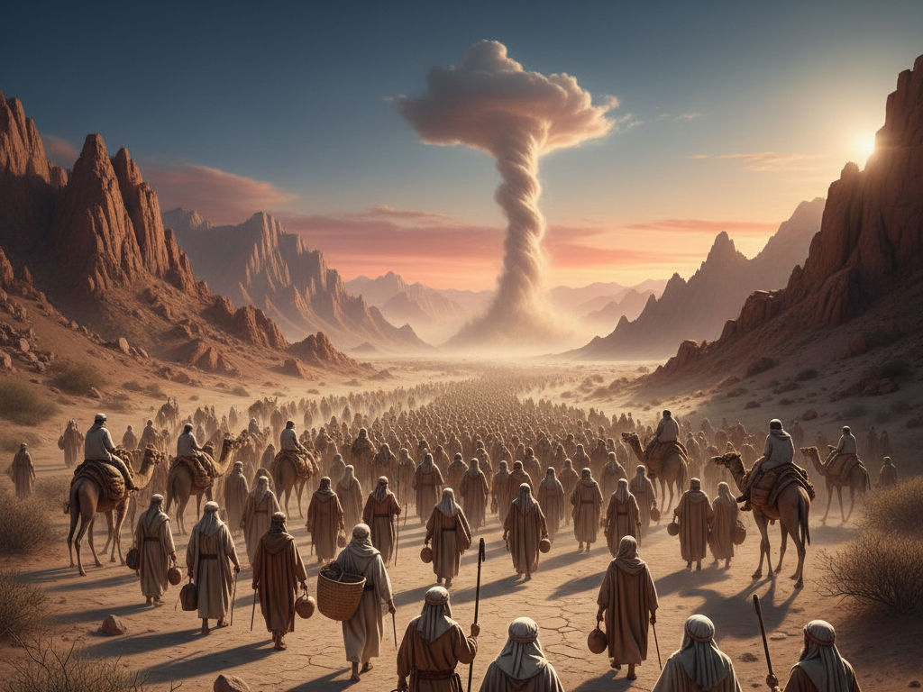
Notes:
Numbers 9:22-23 Or whether it were two days, or a month, or a year, that the cloud tarried upon the tabernacle, remaining thereon, the children of Israel abode in their tents, and journeyed not: but when it was taken up, they journeyed. [23] At the commandment of the LORD they rested in the tents, and at the commandment of the LORD they journeyed: they kept the charge of the LORD, at the commandment of the LORD by the hand of Moses.

Slide 11
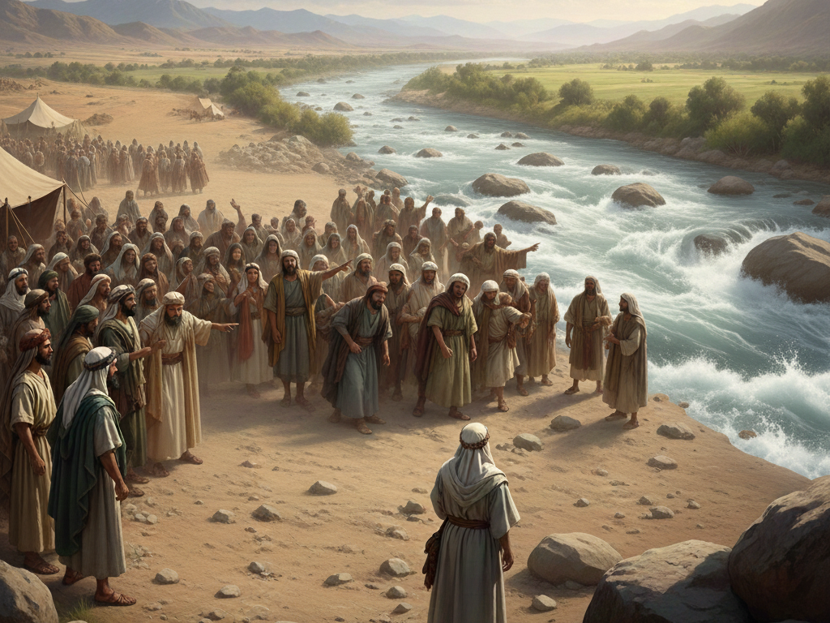
Notes:
Deuteronomy 1:30-31 The LORD your God which goeth before you, he shall fight for you, according to all that he did for you in Egypt before your eyes; 31 And in the wilderness, where thou hast seen how that the LORD thy God bare thee, as a man doth bear his son, in all the way that ye went, until ye came into this place.

Slide 12
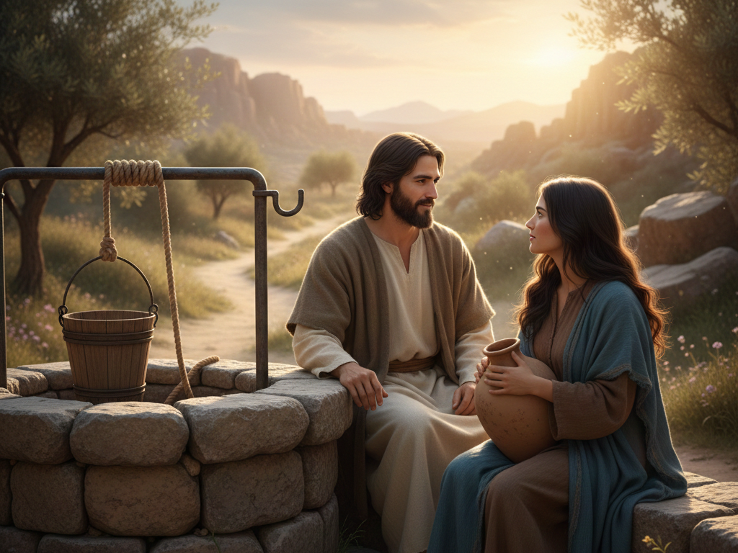
Notes:
Faith is our Victory.

Slide 13
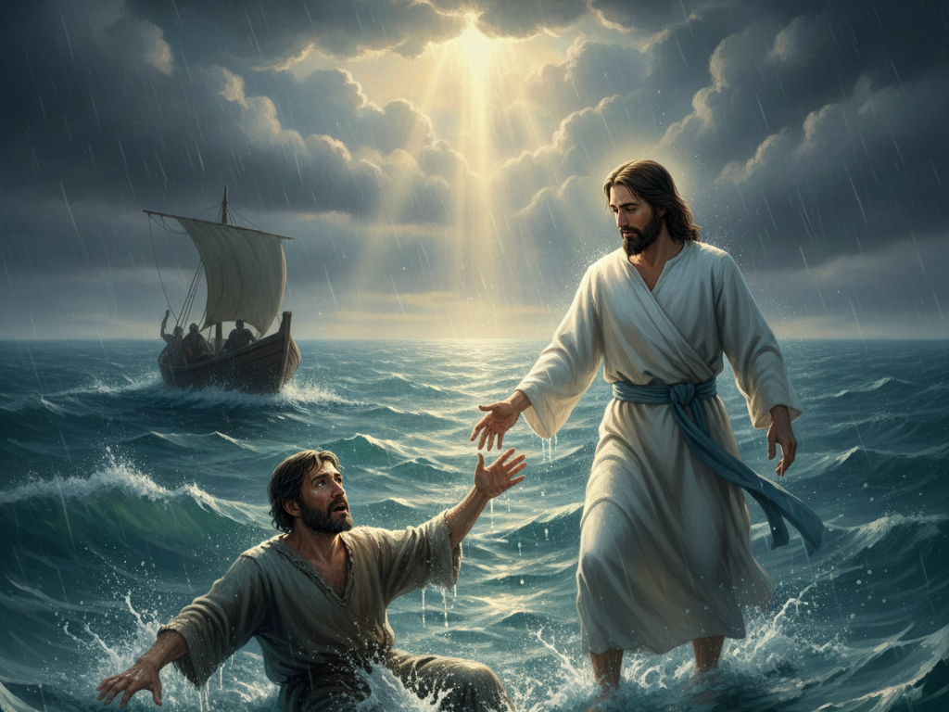

Slide 14
